Slide 1
Probability and statistics 13-NHST p-values, significance level, power
상명대학교 휴먼지능정보공학과

Slide 2
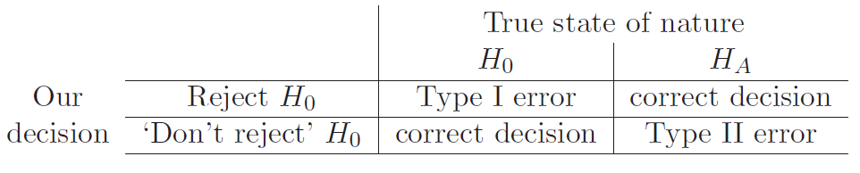
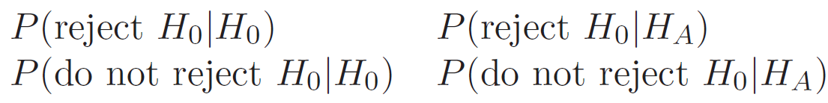
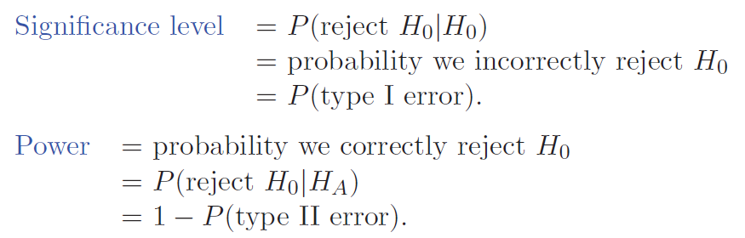
Significance level and power

Slide 3
Significance level and power
Ideally, a hypothesis test should have a small significance level (near 0) and a large power (near 1).
Think of H₀ as the hypothesis ‘nothing noteworthy is going on’, i.e. ‘the coin is fair’, ‘the treatment is no better than placebo’ etc. And think of H_{A} as the opposite: ‘something interesting is happening’.
Then power is the probability of detecting something interesting when it’s present; and significance level is the probability of mistakenly claiming something interesting has occurred.

Slide 4
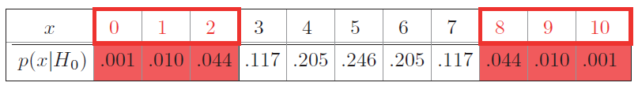
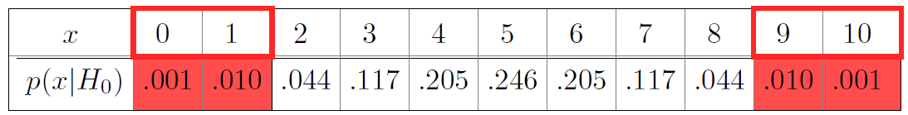
Questions & answers
Coin with probability of heads θ.
Test statistic x = the number of heads in 10 tosses.
H₀: ‘the coin is fair’, i.e. θ =0.5
H_{A}: ‘the coin is biased, i.e. θ in not 0.5
Rejection range:
What is the Significance level of this test? → 0.11
What is the Power of this test? → We can’t compute the power without an alternative distribution.
Given significance level α = .05 find a two-sided rejection region.

Slide 5
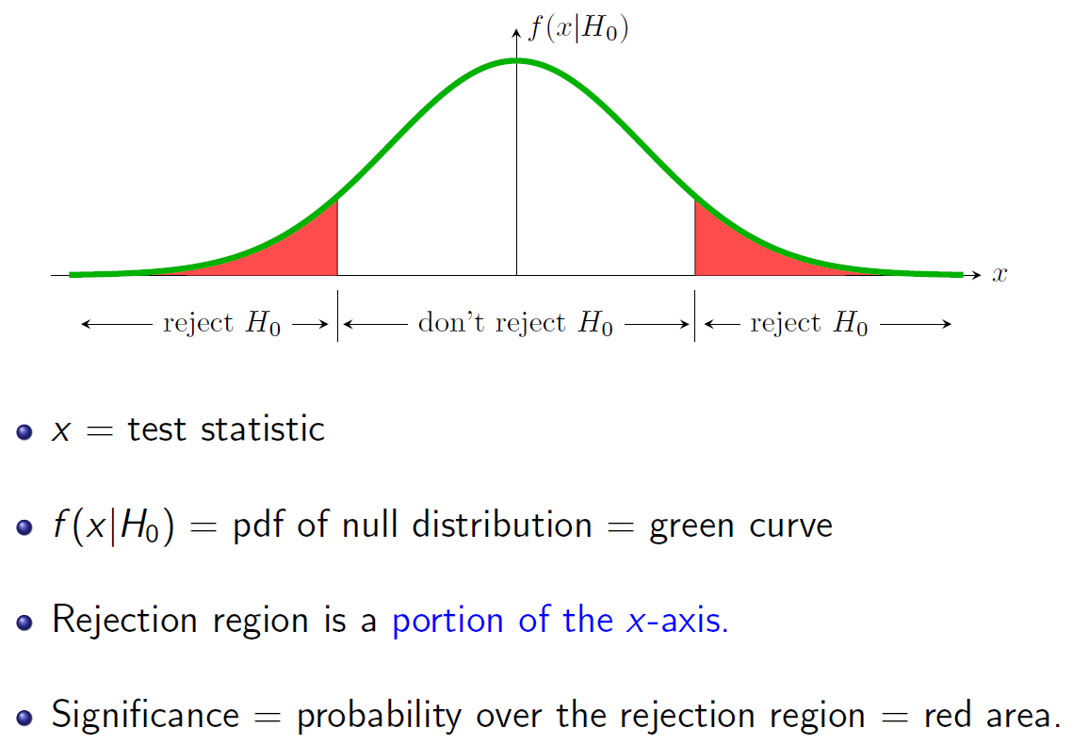

Slide 6
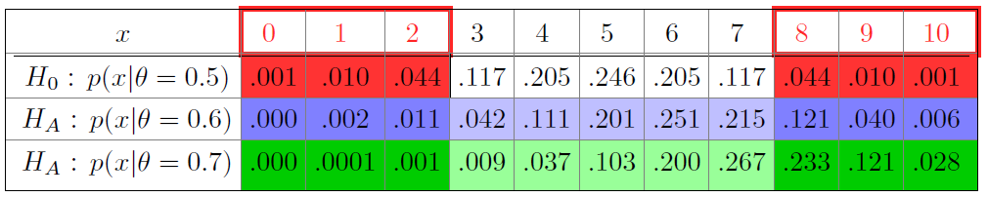
significance level and power
The rejection region is boxed in red. The corresponding probabilities for different hypotheses are shaded below it.
Find the significance level of the test.
Find the power of the test for each of the two alternative hypotheses.
answer:
1. Significance level = P(x in rejection region |H₀) = 0.11
2. If θ = 0.6: power = P(x in rejection region |H_{A}) = 0.18
3. If θ = 0.7: power = P(x in rejection region |H_{A}) = 0.383

Slide 7
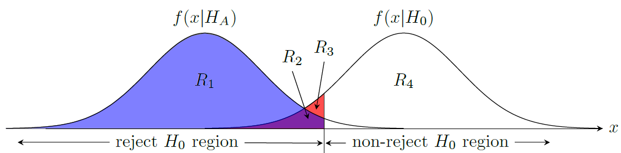
Question
The power of the test in the graph is given by the area of
(a) R1 (b) R2 (c) R1 + R2 (d) R1 + R2 + R3
Hint: Power = P(rejection region |H_{A})
Notes:
R2 +R3 = Significance level

Slide 8
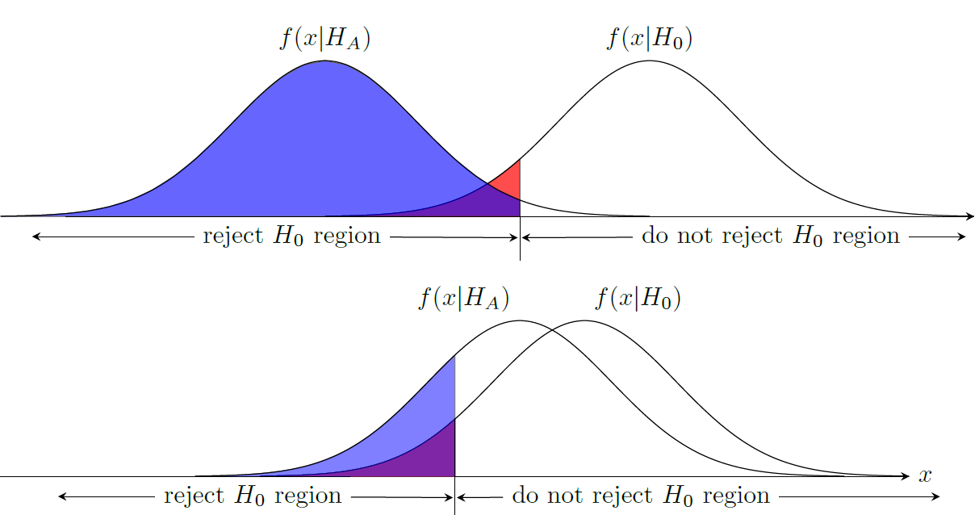
Question
Which test has higher power?
(a) Top (b) Bottom
Hint: Power = P(rejection region |H_{A})
Notes:
TOP

Slide 9
p-value
The p-value is a computational tool to check if the test statistic is in the rejection region. It is also a measure of the evidence for rejecting H₀.
p-value: P(data at least as extreme as x|H₀)
In a significance test, the null hypothesis H₀ is rejected if the p-value is less than or equal to a predefined threshold value α.
α: the alpha level or significance level.

Slide 10
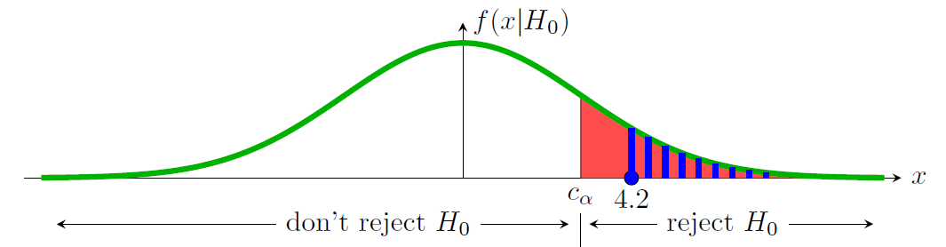
Extreme data and p-values
Example:
Suppose we have the right-sided rejection region shown below. Also suppose we see data with test statistic x = 4.2. Should we reject H₀?
answer: The test statistic is in the rejection region, so reject H₀.
Alternatively we can say: blue area < red area
Significance level: α = P(x in rejection region |H₀) = red area.
p-value: p = P(data at least as extreme as x |H₀) = blue area.
Since, p < α we reject H₀.

Slide 11
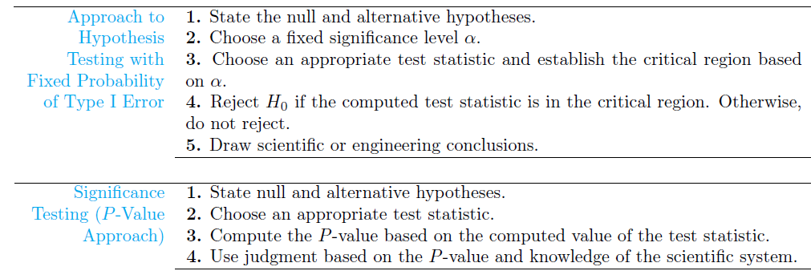
Meaning of p-value
critical region = rejection region

Slide 12
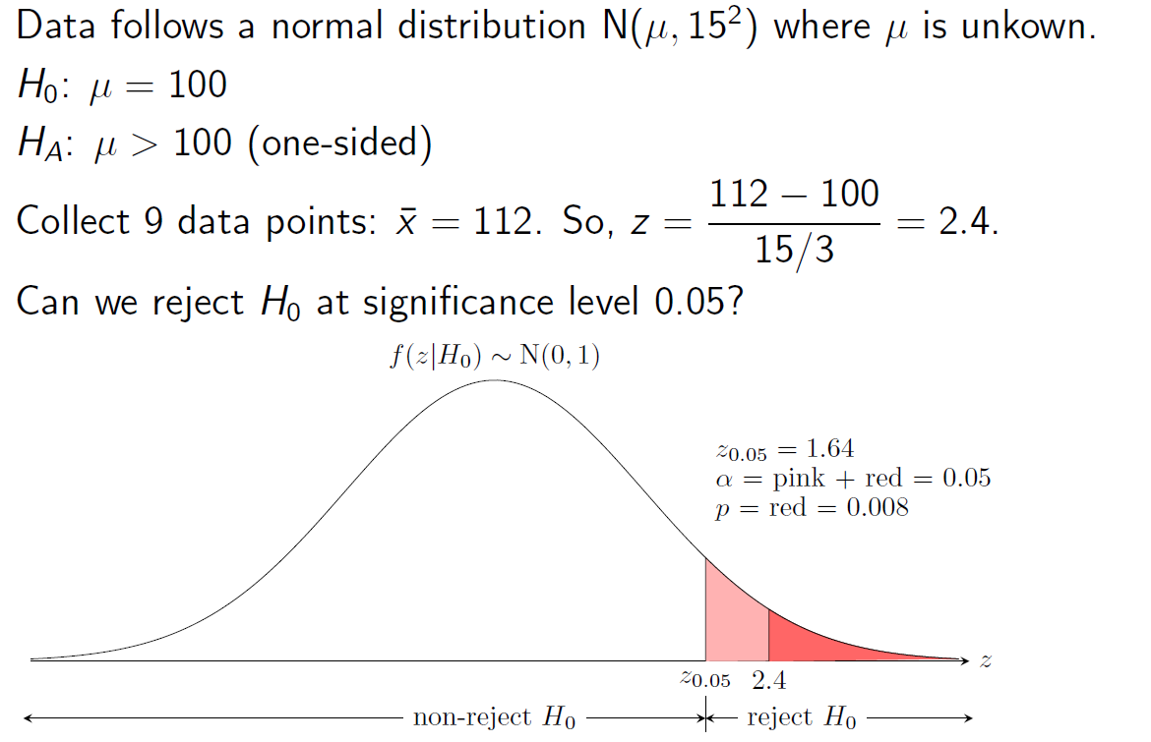
One-sided H_{A}

Slide 13
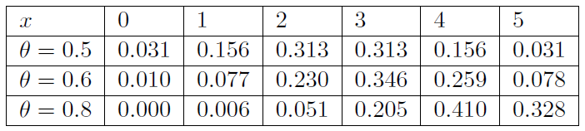
Question
Data is drawn from a binomial(5, θ) distribution, where θ is unknown. Here is the table of probabilities p(x | θ) for 3 values of θ:
You want to run a significance test on the value of θ. You have the following:
Null hypothesis: θ = 0.5.
Alternative hypotheses: θ > 0.5. ← one-sided H_{A}
Significance level: α = 0.1.
(a) Find the rejection region.
(b) Compute the power of the test for each of the two hypotheses θ = 0.6 and θ = 0.8.
(c) Suppose you run an experiment and the data gives x = 4. Compute the p-value of this data.
Notes:
θ = 0.5. rejection region 5: 0.031
θ = 0.6 : power = P(reject | HA), power = P(x=5 | θ = 0.6) = 0.078
θ = 0.8 : power = P(reject | HA), power = P(x=5 | θ = 0.8) = 0.328
P-value : x = 4 일때 , x = 4,5 = 0.187

